Slide 1


Data Analyst
GRADUATION PROJECT
GO
TRADY

Slide 2

OVERVIEW
01
02
03
Introduction
Database
development
DWH Rules
04
05
06
SSIS Pcakges
Star Schema
Business Case

Slide 3




INTRODUCTION
GoTrady is a data-driven project focused on global specialty product trade. It showcases real-world BI practices, leveraging sales transactions, customer profiles, product inventories, and supply chain data for in-depth analysis and decision-making.

Slide 4

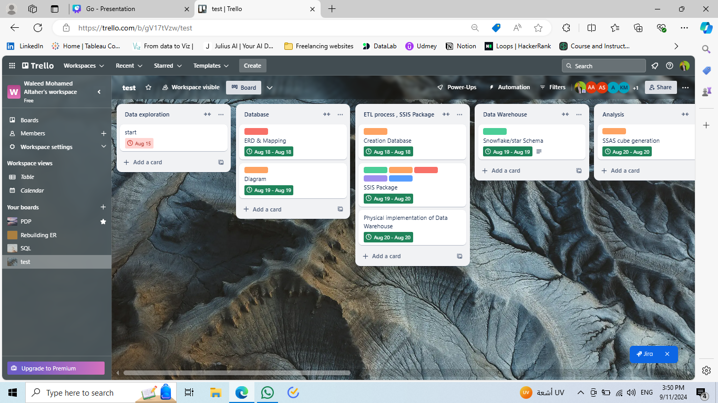
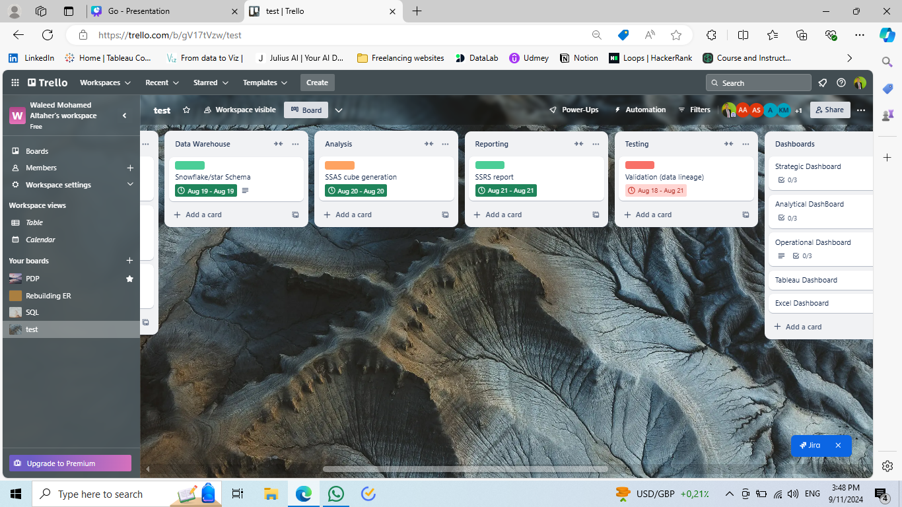
PROJECT MANAGEMENT METHODOLOGY

Slide 5

DATABASE DEVELOPMENT
A)- BUSINESS RULES
ENTITIES
RELATIONSHIPS
A customer can place multiple orders, but some may place none.
Each order belongs to one customer.
Orders must include at least one product.
Products can be in multiple orders.
Each product belongs to one category; categories can contain multiple products.
An employee can handle multiple orders; each order is managed by one employee.
Some employees are supervisors who receive reports.
Employees may report to one manager; multiple employees can share the same manager.
Each order is shipped by one company; a company may handle multiple orders.
Customer Attributes: Customer ID, Company Name, Contact Name, Contact Title, City, Country.
Order Attributes: Order ID, Order Date, Required Date, Shipped Date, Freight.
Product Categories: ID, Name, Description.
Order Details: Unit price at the time of order, quantity, discount.
Employee Attributes: ID, Name, Title, City, Country.
Shipping Company Attributes: ID, Company Name.

Slide 6
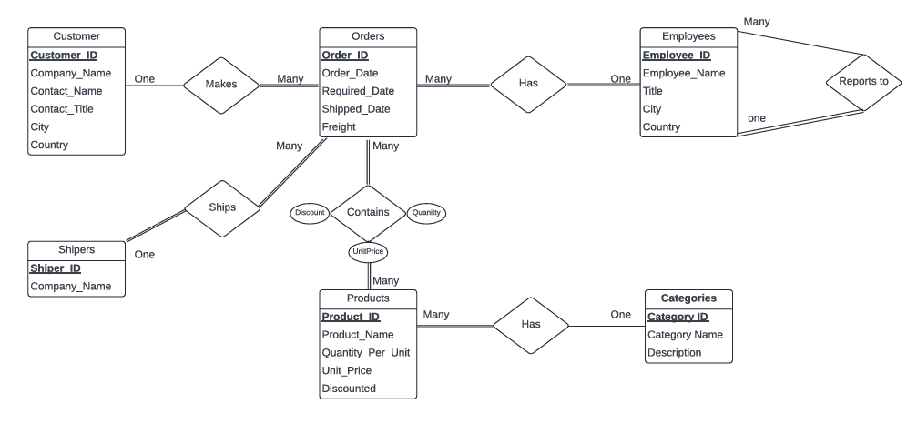
B)-ENTITY RELATIONSHIP DIAGRAM

Slide 7
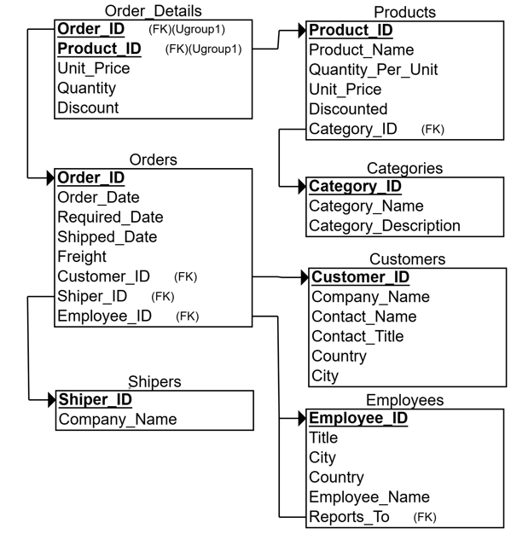
C)-MAPPING

Slide 8
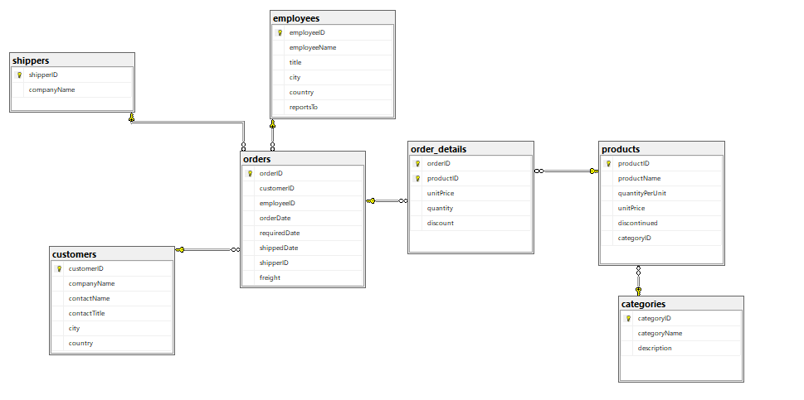
D)-SCHEMA

Slide 9

DWH
Business Process Needed to be measured and upon which the DWH is implemented
Sales Process
Level of details for the DWH is set to be the lowest grain level or transactional level
Lowest Grain
Unit Price, Discount, Quantity
Numeric measures that are set to be the core of the fact table
Employees Shipping
Dimensions that contain descriptive data
Customers Product

Slide 10

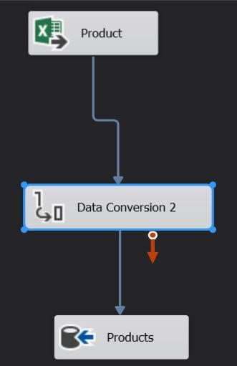
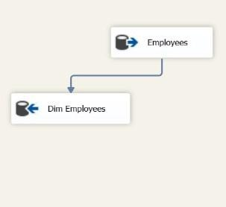
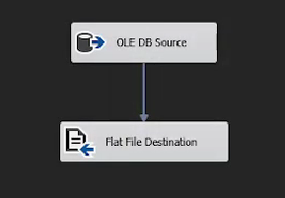
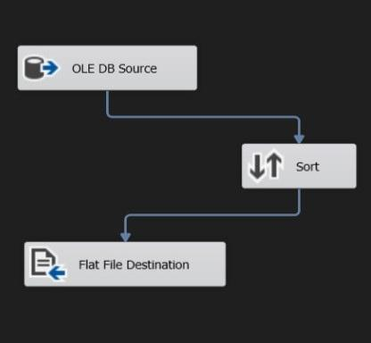
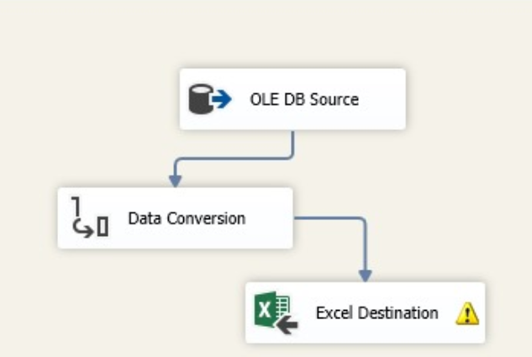
SSIS PACKAGES

Slide 11
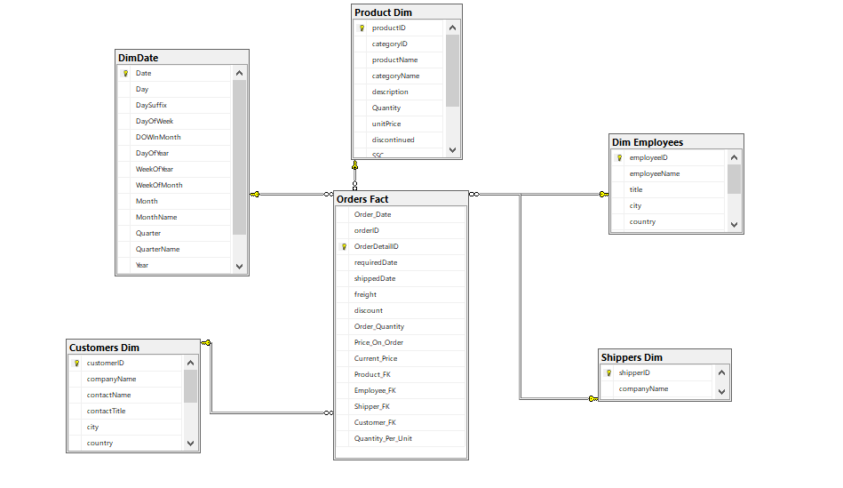
STAR SCHEMA

Slide 12








BUSINESS ANALYSIS CASE
Sales Analysis
Analyzing sales performance and determining the drop in sales periods
Products
Analyzing products and categories' performance over time, determining best, worst, and discontinued products
Customer Segmentation
Segmenting the customers based on RFM Analysis to build customized marketing campaigns for each segment
Shipping Analysis
Analyze the number of orders fulfilled by each shipping company and their average shipping costs. Provide insights on how different shipping options impact customer satisfaction and overall sales
Employees performance Analysis
Performance Analysis over different hierarchies of Employees and managers

Slide 13

01
POWER BI
02
TABLEAU
Reporting Tools
03
EXCEL
04
SSRS

Slide 14
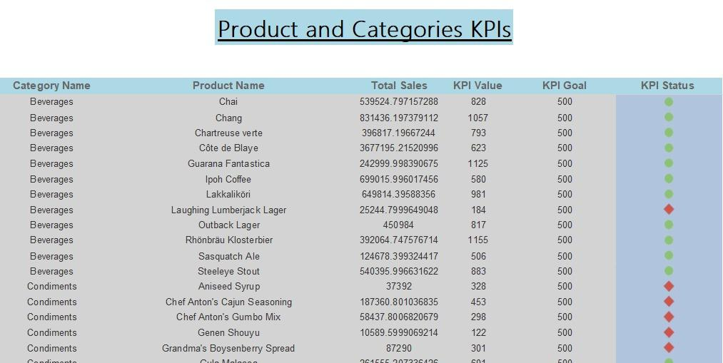
E) REPORTING

Slide 15
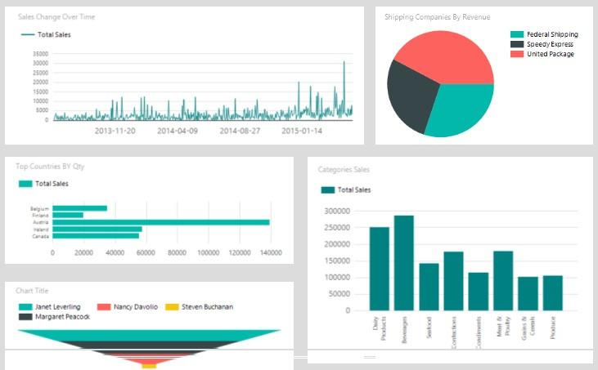
E) REPORTING

Slide 16



Thank's For Watching
Connect with us.
+123-456-7890
GoTrady@reallygreatsite.com

